Slide 1
Advanced SUSE Linux Enterprise Server Administration (Course 3038)
Chapter 2
Configure the Network Manually

Slide 2
Objectives
Understand Linux Network Terms
Set Up Network Devices with the ip Tools
Save Device Settings to a Configuration File
Set Up Routing with the ip Tool
Advanced SUSE Linux Enterprise Server Administration (Course 3038)

Slide 3
Objectives (continued)
Save Routing Settings to a Configuration File
Configure Host Name and Name Resolution
Test the Network Connection with Command-Line Tools
Advanced SUSE Linux Enterprise Server Administration (Course 3038)

Slide 4
Understand Linux Network Terms
Device
  Network adapter built into the system
Link
  Used by command-line tool ip to refer to the connection of a device to the network
Address
  IP address assigned to a device
Broadcast
  Refers to the broadcast address of a network
Route
  Path IP packet takes from source to destination host
Advanced SUSE Linux Enterprise Server Administration (Course 3038)

Slide 5
Set Up Network Devices with the ip Tool
Command-line ip tool
  Changes the network card configuration
Used to perform the following tasks
  Display the Current Network Configuration
  Change the Current Network Configuration
Advanced SUSE Linux Enterprise Server Administration (Course 3038)

Slide 6
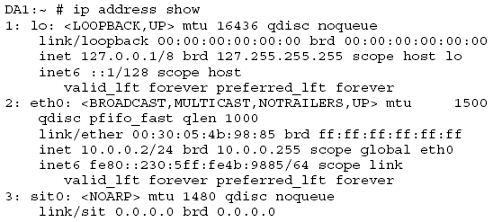
Display the Current Network Configuration
IP address setup
  Syntax
    ip address show
Advanced SUSE Linux Enterprise Server Administration (Course 3038)

Slide 7
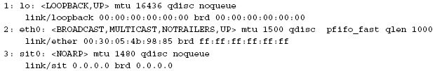
Display the Current Network Configuration (continued)
Device attributes
  Syntax
    ip link show
  Possible attributes
    UP, LOOPBACK
    BROADCAST, POINTOPOINT
    MULTICAST, PROMISC
Advanced SUSE Linux Enterprise Server Administration (Course 3038)

Slide 8
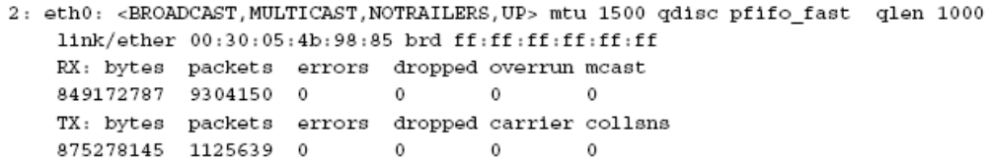
Display the Current Network Configuration (continued)
Device statistics
  Syntax
    ip –s link show eth0
  Information displayed
    Bytes, packets, errors
    Dropped, overrun, mcast
    Carrier, collsns, compressed
Advanced SUSE Linux Enterprise Server Administration (Course 3038)

Slide 9
Change the Current Network Configuration
Assign an IP address to a device
  ip address add 10.0.0.2/24 brd + dev eth0
  Verify assigned IP address
    ip address show dev eth0
Delete the IP address from a device
  ip address del 10.0.0.2 dev eth0
Change device attributes
  ip link set device attribute
  Enable/Disable a network device
    ip link set eth0 up/down
Advanced SUSE Linux Enterprise Server Administration (Course 3038)

Slide 10
Save Device Settings to a Configuration File
Changes made with ip are temporary
Network device configuration files
  Stored in directory /etc/sysconfig/network
  Filenames consist of ifcfg-eth-id-and the hardware address of the device (on OpenSUSE file names consist of ifcfg-eth-id)
Set up a device with YaST first
  Then make changes in the configuration file
ip link show
  Displays hardware address for each Ethernet device
Advanced SUSE Linux Enterprise Server Administration (Course 3038)

Slide 11
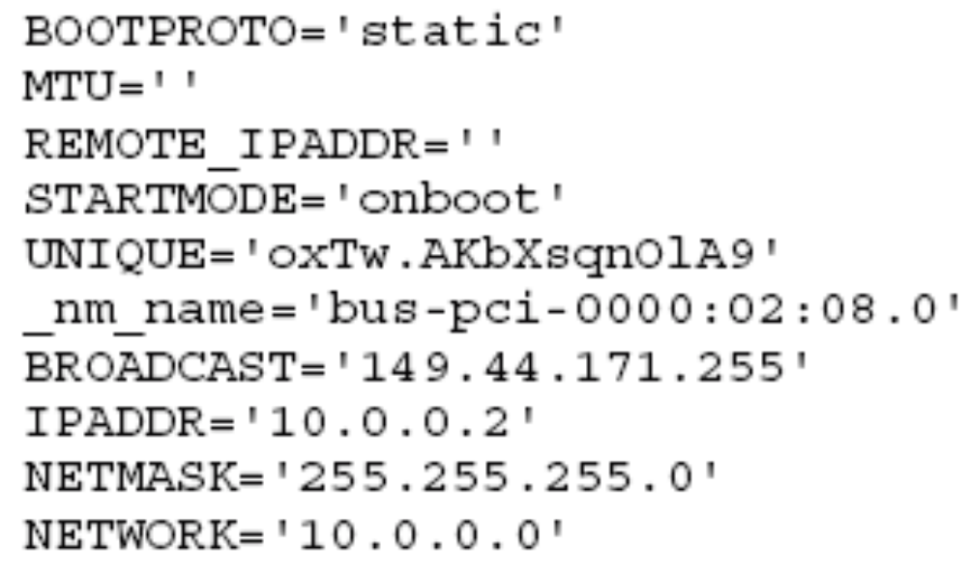
Configure a Device Statically
Content of a configuration file example
Advanced SUSE Linux Enterprise Server Administration (Course 3038)

Slide 12
Configure a Device Dynamically with DHCP
Set the BOOTPROTO option to dhcp
  BOOTPROTO=‘dhcp’
You don’t need to set any other options
Advanced SUSE Linux Enterprise Server Administration (Course 3038)

Slide 13
Start and Stop Configured Devices
Disable device eth0
  ifdown eth0
Enable device eth0
  ifup eth0
Advanced SUSE Linux Enterprise Server Administration (Course 3038)

Slide 14
Set Up Routing with the ip Tool
Use ip tool to
  View the Routing Table
  Add Routes to the Routing Table
  Delete Routes from the Routing Table
Advanced SUSE Linux Enterprise Server Administration (Course 3038)

Slide 15
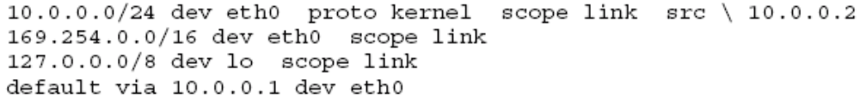
View the Routing Table
Syntax
  ip route show
Routing table content varies
  Depending on the setup of your machine
  You have at least two entries
    One route to the local network to which the system is connected
    One route to the default gateway for all other packets
Advanced SUSE Linux Enterprise Server Administration (Course 3038)

Slide 16
Add Routes to the Routing Table
Set a route to the locally connected network
  ip route add 10.0.0.0/24 dev eth0
Set a route to a different network
  ip route add 149.44.171.0/24 via 10.0.0.100
Set a default route
  ip route add default via 10.0.0.1
Advanced SUSE Linux Enterprise Server Administration (Course 3038)

Slide 17
Delete Routes from the Routing Table
Syntax
  ip route delete 149.44.171.0/24 dev eth0
Advanced SUSE Linux Enterprise Server Administration (Course 3038)

Slide 18
Save Routing Settings to a Configuration File
Routing settings made with the ip tool are temporary
Routes configuration file
  /etc/sysconfig/network/routes
Typical configuration file example
Advanced SUSE Linux Enterprise Server Administration (Course 3038)

Slide 19
Configure Host Name and Name Resolution
Objectives
  Set the Host and Domain Name
  Configure Name Resolution
Advanced SUSE Linux Enterprise Server Administration (Course 3038)

Slide 20
Set the Host and Domain Name
Host name is configured in the file /etc/HOSTNAME
The content of the file is similar to the following:
  da2.digitalairlines.com
Advanced SUSE Linux Enterprise Server Administration (Course 3038)

Slide 21
Configure Name Resolution
Name resolution is configured in the file /etc/resolv.conf
Content of the file is similar to the following:
  search digitalairlines.com
  nameserver 10.0.0.1
  nameserver 10.10.0.1
  nameserver 10.0.10.1
File contains two types of entries
  search
  nameserver
Advanced SUSE Linux Enterprise Server Administration (Course 3038)

Slide 22
Test the Network Connection with Command-Line Tools
Test network connection by doing the following:
  Use ping to Test Network Connections
  Use traceroute to Trace Network Packets
Advanced SUSE Linux Enterprise Server Administration (Course 3038)

Slide 23
Use ping to Test Network Connections
Tool ping
  Checks network connections between two hosts
Syntax
  ping 10.0.0.1
Information displayed
  The size of an ICMP datagram
  The IP address of the target system
  The sequence number of each datagram
  The TTL (time to live) of the datagram
  The Round Trip Time
Advanced SUSE Linux Enterprise Server Administration (Course 3038)

Slide 24
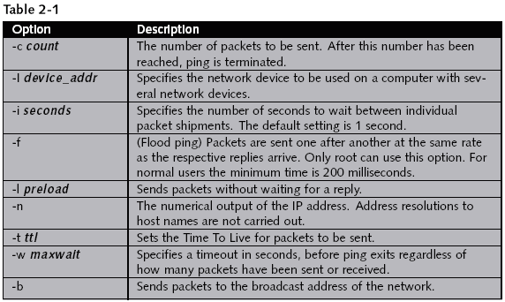
Use ping to Test Network Connections (continued)
Advanced SUSE Linux Enterprise Server Administration (Course 3038)

Slide 25

Use traceroute to Trace Network Packets
Diagnosis tool traceroute
  Checks the routing between different networks
  Sends packets with an increasing TTL value to the destination host
Syntax
  traceroute pluto.example.com
Advanced SUSE Linux Enterprise Server Administration (Course 3038)

Slide 26
Exercise 2-1 Configure the Network Connection Manually
In this exercise, you will do the following:
  Part I: Note the Current Network Configuration
  Part II: Delete the Current Network Setup with YaST
  Part III: Configure the Network Manually
  Part IV: Save the Network Connection to Interface and Hardware Configuration Files
Advanced SUSE Linux Enterprise Server Administration (Course 3038)

Slide 27
Summary
Hosts use network devices linked to the network
  To communicate with other computers
Each network device has at least one IP address
  That may be configured using the ip command
Network interface and IP information is stored in the /etc/sysconfig/network directory
Different IP networks are connected via routers
Each host contains a hostname
  Stored in the /etc/HOSTNAME file
Advanced SUSE Linux Enterprise Server Administration (Course 3038)

Slide 28
Summary (continued)
Connect to network resources by name
  A host contains the addresses of up to three name servers in the /etc/resolv.conf file
The ping and traceroute commands
  Use datagrams to test network communication and routing
Advanced SUSE Linux Enterprise Server Administration (Course 3038)

